Slide 1

Reinforcement Learning Snake Game
Serena Lyou, Stephi Lyou, Hari Sharmaa

Slide 2
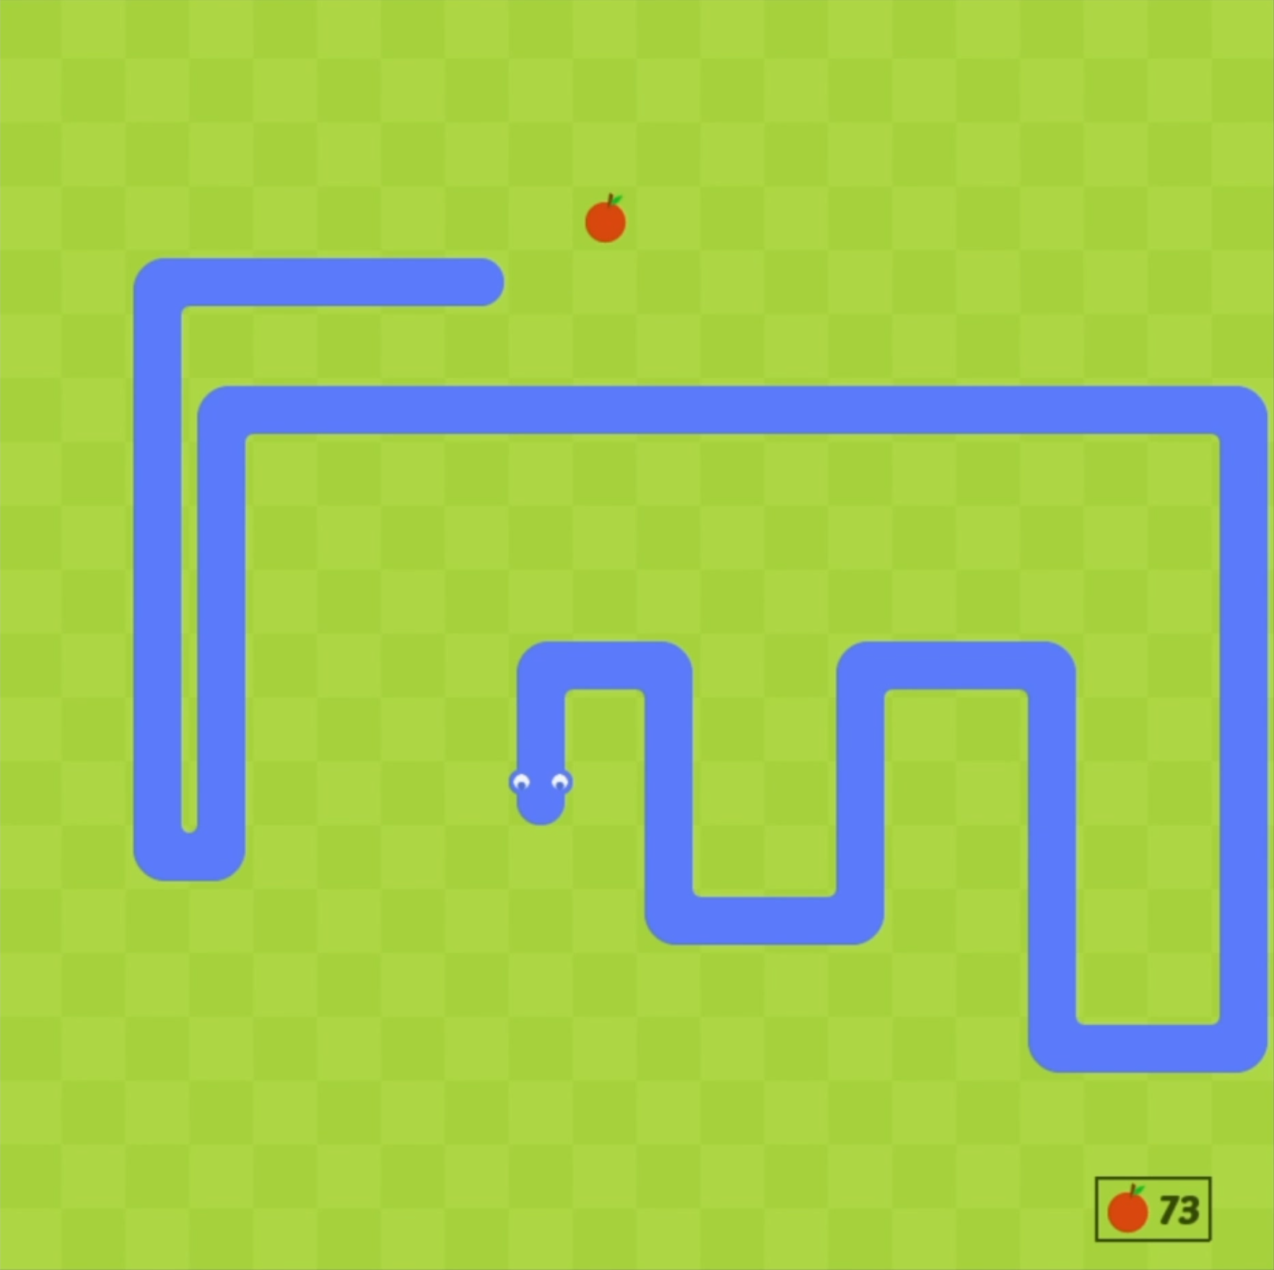
Task Description
Problem Statement:
Enable an agent to learn and optimize its performance in the
Snake game through reinforcement learning techniques.
Game Objective:
Control the snake to eat food, grow longer, and avoid collisions with walls or itself.
Maximize the score by consuming as much food as possible without dying.
Reinforcement Learning Framework:
Environment: Snake game grid.
Agent: Learns to make movement decisions.
Actions: 'STRAIGHT', 'LEFT', 'RIGHT’.
Rewards: Positive for eating food, negative for collisions or inefficient movements.

Slide 3
System Architecture
config.py: Contains configuration settings and hyperparameters.
game.py: Manages game mechanics and rendering using Pygame.
helper.py: Provides utility functions for tasks like managing high scores.
model.py: Defines the DQN model and the replay memory.
agents.py: Implements the different agents—DQNAgent, TabularQAgent, and RandomAgent.
main.py: Orchestrates the training loop and game execution based on the selected agent.

Slide 4
Dataset
Unlike traditional supervised learning, generated through agent’s interaction with the environment.
Features Comparison Table:
Feature | DQN Agent | Tabular Q-Learning Agent
State Representation | 12-dimensional vector | Tuple (danger_code, direction, food_direction)
State Features | Danger indicators, direction, food direction, normalized distance | Danger code, current direction, food direction
Learning Method | Neural network approximates Q-values | Q-table stores Q-values for each state-action pair
Experience Replay | Yes | No

Slide 5
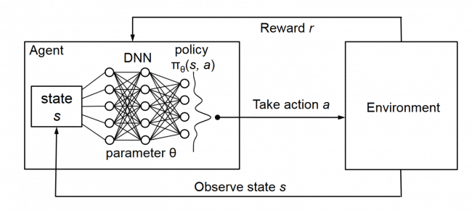
Deep Q-Network
Architecture
Input Layer: 12-dimensional state vector.
Hidden Layers: Two fully connected layers with 128 neurons each, activated by ReLU.
Output Layer: Produces Q-values for each possible action—straight, left, and right.

Slide 6
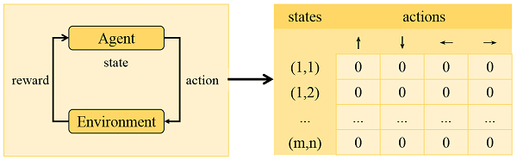
Tabular Q-Learning
Architecture
State Representation: Encoded as a tuple (danger_code, direction, food_direction).
Update Rule: Same as the Q-Learning update equation.
Exploration Strategy: Epsilon-greedy policy

Slide 7
Implemented Agents
DQN Agent
neural network
experience replay and a target network
epsilon-greedy policy
TabularQ Agent
Q-table
Discrete state spaces
epsilon decay
Random Agent
Random Action
baseline

Slide 8
Training Process
Episodes
Total of 10,000 training episodes.
Epsilon-Greedy Strategy
Initial Epsilon: 1.0 (full exploration).
Decay Rate: 0.995 per episode.
Minimum Epsilon: 0.01.
Rewards Structure
+10: Eating food.
-0.1: Moving without eating (encourages efficiency).
-10: Collisions (walls or self)..
Experience Replay (DQN):
Stores experiences in a deque.
Samples mini-batches of size 64 for training.
Target Network Updates (DQN):
Frequency: Every 20 episodes.
Purpose: Stabilizes learning by providing consistent target Q-values.

Slide 9
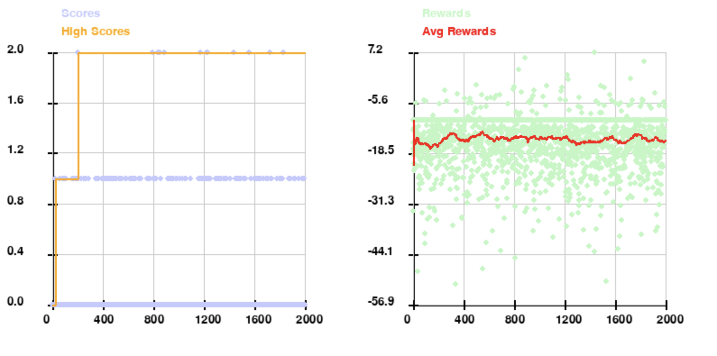
Results - Random Agent

Slide 10
Episode | High Score | Average Reward (last 100)
100 | 1 | -16.22
200 | 1 | -16.11
300 | 2 | -13.62
400 | 2 | -15.06
500 | 2 | -13.94
600 | 2 | -14.47
700 | 2 | -14.45
800 | 2 | -14.33
900 | 2 | -15.03
1000 | 2 | -14.55
1100 | 2 | -14.37
1200 | 2 | -14.51
1300 | 2 | -15.85
1400 | 2 | -15.71
1500 | 2 | -15.13
1600 | 2 | -15.00
1700 | 2 | -15.22
1800 | 2 | -13.86
1900 | 2 | -15.20
2000 | 2 | -15.05

Slide 11
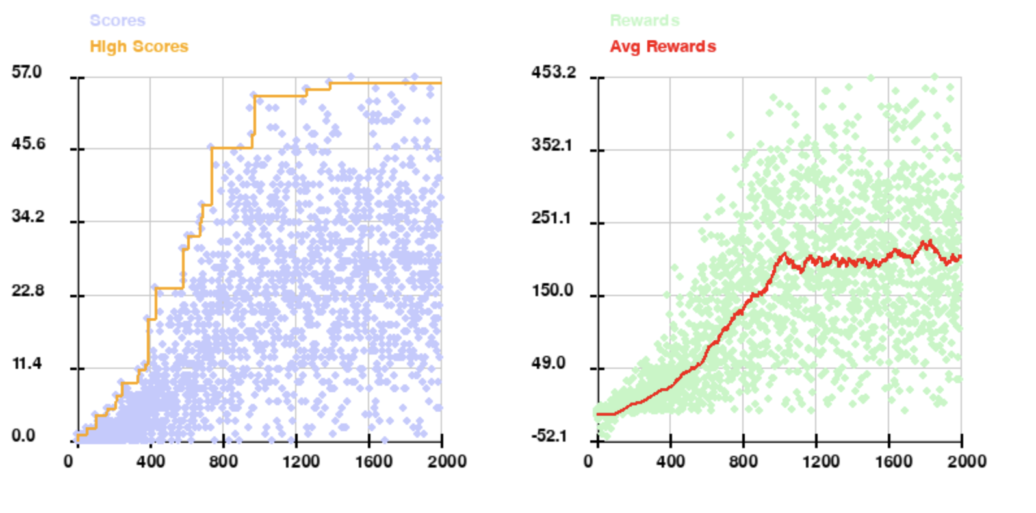
Results - Tabular Q-Learning

Slide 12
Episode | High Score | Epsilon | Average Reward (last 100)
100 | 2 | 0.6058 | -14.34
200 | 5 | 0.3670 | -0.47
300 | 9 | 0.2223 | 9.46
400 | 19 | 0.1347 | 22.11
500 | 24 | 0.0816 | 44.79
600 | 30 | 0.0494 | 69.48
700 | 37 | 0.0299 | 102.77
800 | 46 | 0.0181 | 130.75
900 | 46 | 0.0110 | 149.01
1000 | 54 | 0.0100 | 201.40
1100 | 54 | 0.0100 | 188.73
1200 | 54 | 0.0100 | 192.33
1300 | 55 | 0.0100 | 204.24
1400 | 56 | 0.0100 | 194.69
1500 | 56 | 0.0100 | 188.88
1600 | 56 | 0.0100 | 206.36
1700 | 56 | 0.0100 | 203.68
1800 | 56 | 0.0100 | 220.50
1900 | 56 | 0.0100 | 199.42
2000 | 56 | 0.0100 | 203.07

Slide 13
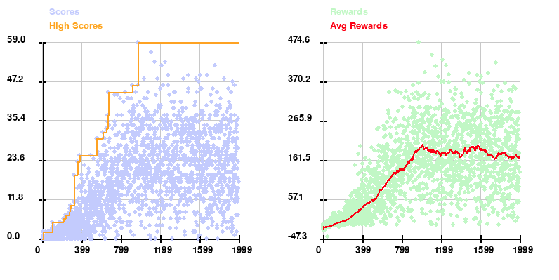
Results - Deep Q-Network

Slide 14
Episode | High Score | Epsilon | Average Reward (last 100)
100 | 2 | 0.6058 | -11.36
200 | 5 | 0.3670 | -0.38
300 | 10 | 0.2223 | 14.19
400 | 25 | 0.1347 | 35.64
500 | 25 | 0.0816 | 56.07
600 | 30 | 0.0494 | 83.53
700 | 44 | 0.0299 | 121.95
800 | 44 | 0.0181 | 138.35
900 | 44 | 0.0110 | 161.53
1000 | 59 | 0.0100 | 199.84
1100 | 59 | 0.0100 | 182.86
1200 | 59 | 0.0100 | 180.93
1300 | 59 | 0.0100 | 187.92
1400 | 59 | 0.0100 | 169.29
1500 | 59 | 0.0100 | 195.46
1600 | 59 | 0.0100 | 190.00
1700 | 59 | 0.0100 | 174.12
1800 | 59 | 0.0100 | 177.37
1900 | 59 | 0.0100 | 168.96
2000 | 59 | 0.0100 | 167.00

Slide 15
Algorithm | Episode | High Score | Average Reward
Random Agent | 100 | 1 | -16.22
 | 500 | 2 | -13.94
 | 1000 | 2 | -14.55
 | 1500 | 2 | -15.13
 | 2000 | 2 | -15.05
Q-Learning | 100 | 2 | -14.34
 | 500 | 24 | 44.79
 | 1000 | 54 | 201.4
 | 1500 | 56 | 188.88
 | 2000 | 56 | 203.07
Deep Q-Network | 100 | 2 | -11.36
 | 500 | 25 | 56.07
 | 1000 | 59 | 199.84
 | 1500 | 59 | 195.46
 | 2000 | 59 | 167
Overall
Results

Slide 16
Discussion
Both reinforcement learning algorithms demonstrated strong learning capabilities compared to the random agent.
Deep Q-Network resulted in a higher score of 59 compared to Q-Learning’s high score of 56.
Deep Q-Network has a faster convergence compared to Tabular Q-Learning as DQN reaches its high score by episode 1000, compared to Tabular Q-Learning at episode 1500.
Best Results Achieved in this Project:
DQN – 73
Tabular - 68

Slide 17
Future Work
Prioritized Experience Replay
Implement Learning Rate Scheduling
Genetic Algorithm

Slide 18
Thank you for watching!
Any further questions can be directed to:
Serena Lyou

